Slide 1
Singleton Pattern
Creational Design Pattern
Page 211

Slide 2
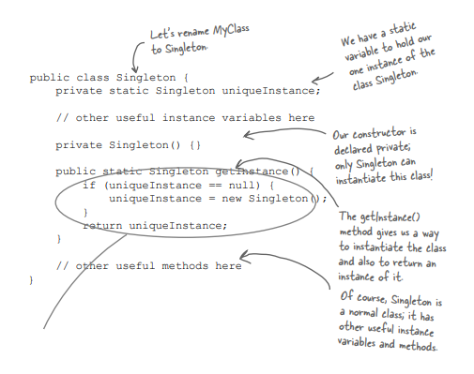
Can not create an object of this class with a new operator outside this class due to private constructor
Use case
Singleton Obj = Singleton.getInstance( )

Slide 3
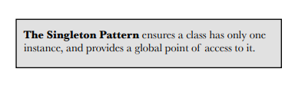
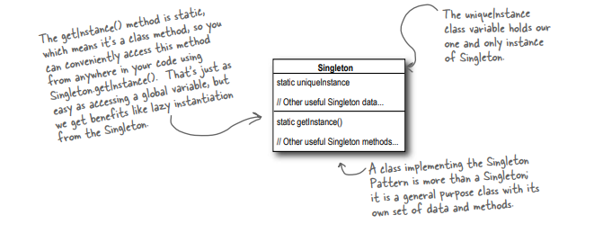

Slide 4
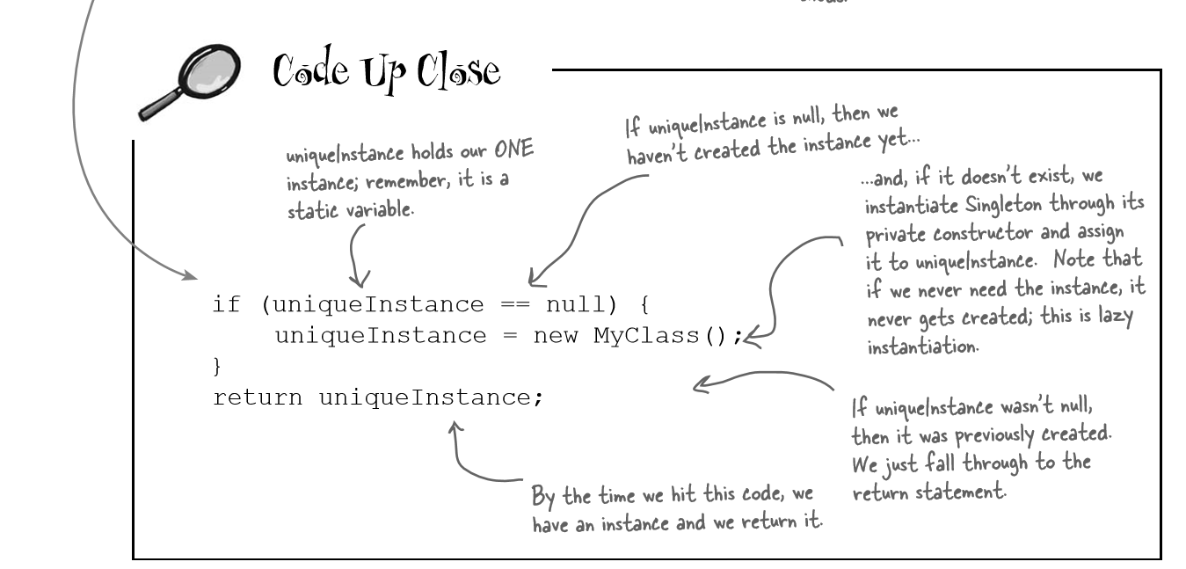

Slide 5
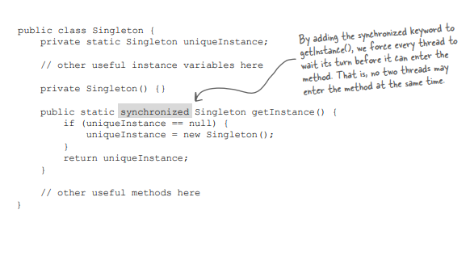
Dealing with multithreading
Thread consistency has been considered though “syncronized” operation is time consuming
Vs.
Problem ?
No Thread consistency considered
Problem ?

Slide 6
Problem ?
Let us consider two threads.
Thread1 is checking this line (if uniqueInstance == null) then context switching happens to Thread2
Thread2 also finds this statement true. Then again context switching appears
Now Thread1 executes its following lines which results in the creation of the object
And after context switching, Thread2 also creates another copy of the object
The main goal of the Singleton Pattern violates.

Slide 7
Problem ?
Solves the concurrency issue
But, if repeatedly this block is called in a thread based application, it slows down the average parallel execution due to the prioritization over the synchronization

Slide 8
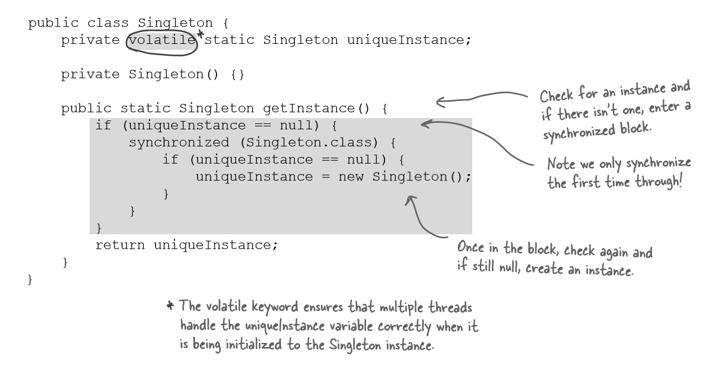
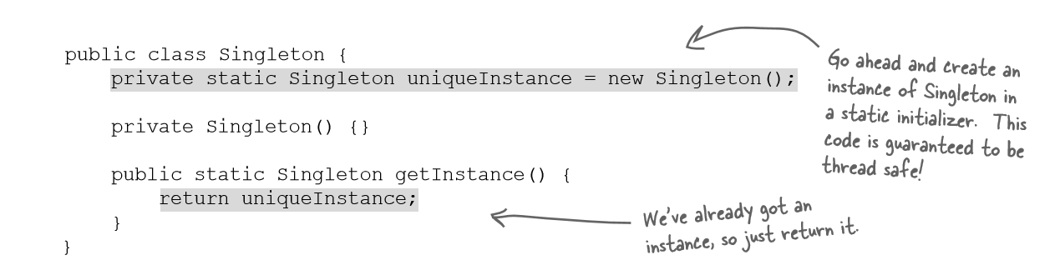
Possible Two Improvements

Slide 9
Each time when we need a reference of the Singleton Object, we call this function
But, only when we need to create a new reference, only then, we synchronize the blocks
Other times, no synchronization, just direct reference nullity check and return
Each time when we need a reference of the Singleton Object, we call this function with a synchronization feature.
All the parallel executables/code fragments synchronize resulting in slower performance

Slide 10
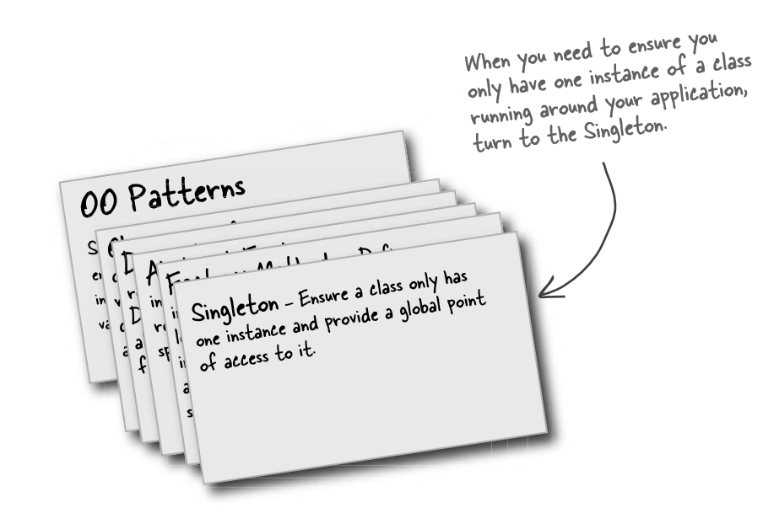
Summary

